Slide 1
Digital Portfolio
STUDENT NAME: LAVANYA. M
REGISTER NO ND NMID: 212401736/
DEPARTMENT: BCA
COLLEGE: COLLEGE/ UNIVERSITY:NAZARETH COLLEGE OF
ARTS AND SCIENCE/MADRAS UNIVERSITY
578796BC63EFB0BAA104A7AD6D7C0B0F

Slide 2
PROJECT TITLE
student digital portfolio

Slide 3


AGENDA
Problem Statement
Project Overview
End Users
Tools and Technologies
Portfolio design and Layout
Features and Functionality
Results and Screenshots
Conclusion
Github Link
3/21/2024 Annual Review

Slide 4

PROBLEM STATEMENT
The problem is that without a structured, accessible, and visually appealing portfolio, students struggle to showcase their talents and connect with potential employers, internship providers, or academic mentors.
This project aims to solve this issue by creating a Student Portfolio Website where students can easily share their personal information, educational qualifications, technical and soft skills, and contact details in a well-organized manner. The portfolio is designed to be interactive, responsive, and user-friendly, helping students build a professional online presence and improve their networking opportunities.

Slide 5
PROJECT OVERVIEW
The Student Portfolio project is a personal website that showcases my academic achievements, skills, and contact information in a simple yet professional way.
The main objective of this project is to present myself effectively to peers, mentors, and potential employers while improving my web development skills. I have designed this portfolio using HTML, CSS and JavaScript.
Interactive features like buttons and links to my LinkedIn profile enhance user experience and make it easier to connect with me. practice structuring content in an organized way.

Slide 6

WHO ARE THE END USERS?
The end users of this student portfolio are primarily the student who creates it, allowing them to showcase their skills, education, and projects in a professional and organized manner.
The interactive elements, like the “Say Hello” button, are included to make the experience more engaging and user-friendly for viewers who want to connect or learn about my work.

Slide 7

TOOLS AND TECHNIQUES
I used HTML, CSS, and JavaScript to create a clean, responsive, and interactive website
. HTML was used to structure the content, such as the about section, education, skills, and contact details.
CSS was applied to style the website with colors, fonts, layouts, and animations to make it visually appealing and user-friendly. JavaScript was used to add interactivity
Together, these tools and techniques helped me build a professional and engaging portfolio

Slide 8
POTFOLIO DESIGN AND LAYOUT
The portfolio is designed with a clean and modern layout that makes it easy for users to navigate and find information
Each section is well-organized with headings, lists, images, and buttons to clearly present the content
The layout focuses on simplicity and readability, making it user-friendly for visitors who want to learn about my background and connect with me.
8

Slide 9
FEATURES AND FUNCTIONALITY
The portfolio includes several useful features and functions that enhance the user experience.
It has a responsive design that adapts to different screen sizes, making it accessible on both mobile and desktop devices
the portfolio combines functionality with aesthetics to create an effective platform for showcasing skills and connecting with others.

Slide 10
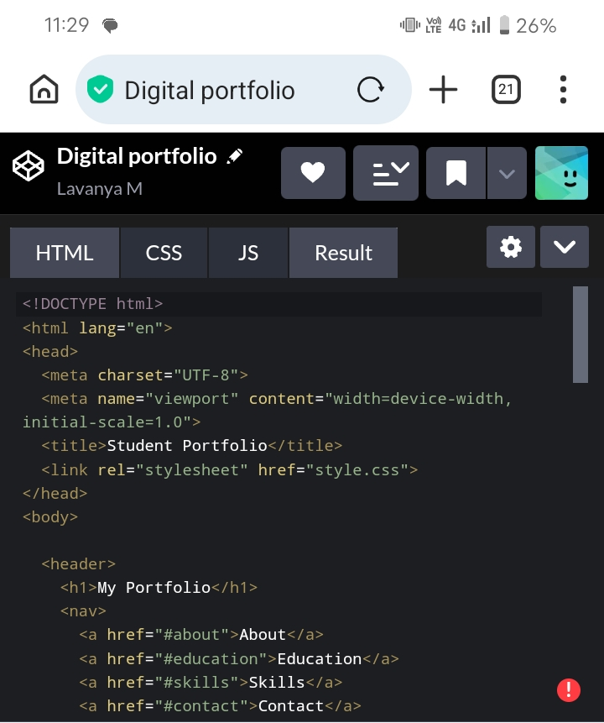
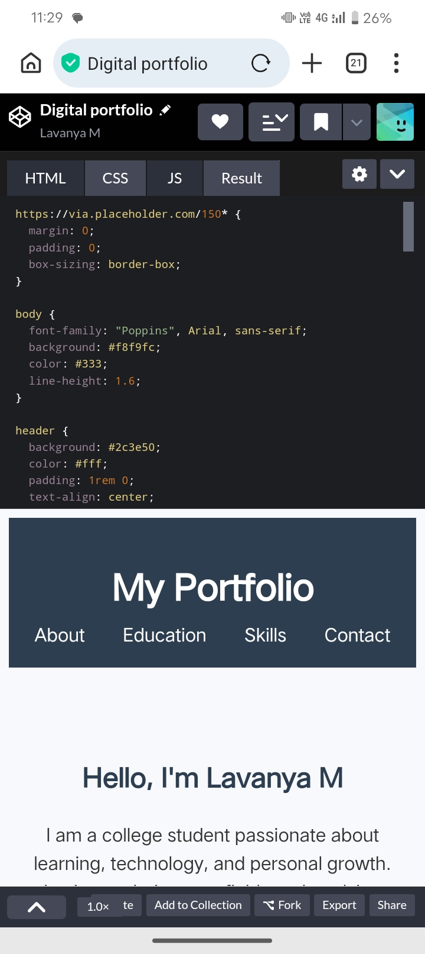
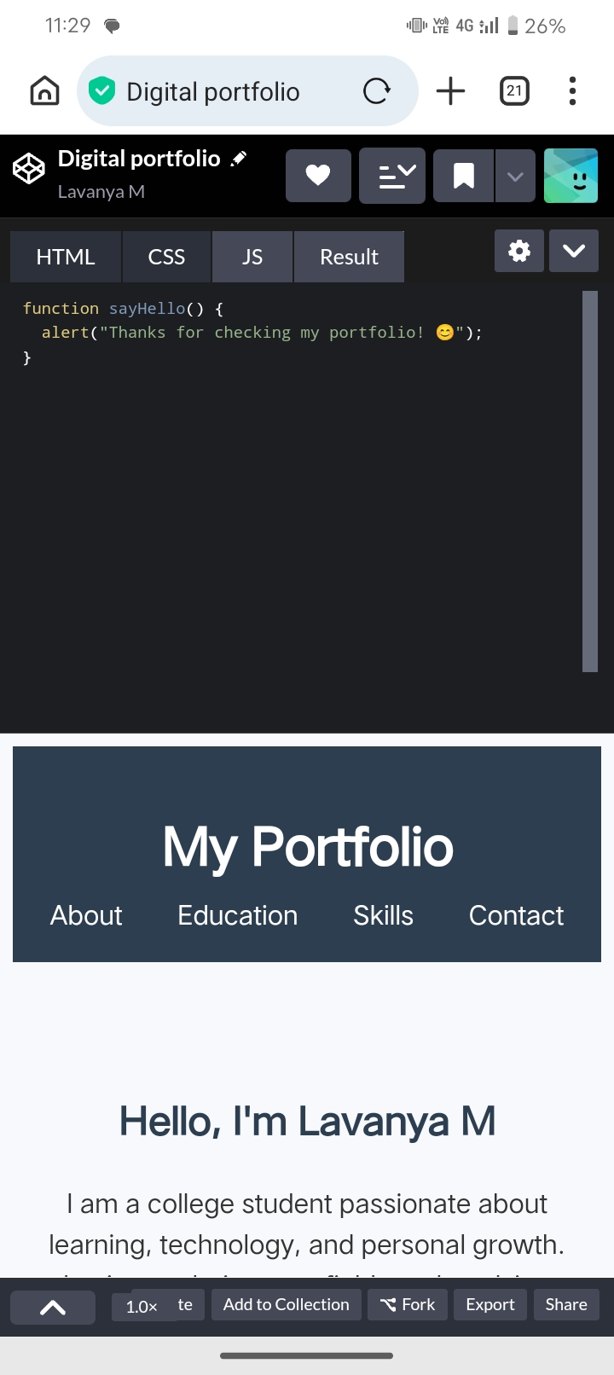

RESULTS AND SCREENSHOTS
3/21/2024 Annual Review
10

Slide 11
CONCLUSION
Interactive Design: Uses HTML, CSS, and JavaScript for a dynamic user experience.
Responsive Layout: Works smoothly on desktop, tablet, and mobile devices.
Showcases Skills: Clearly displays personal projects, achievements, and abilities.
User-Friendly Navigation: Simple menus, buttons, and alerts for easy access.
11

Slide 12
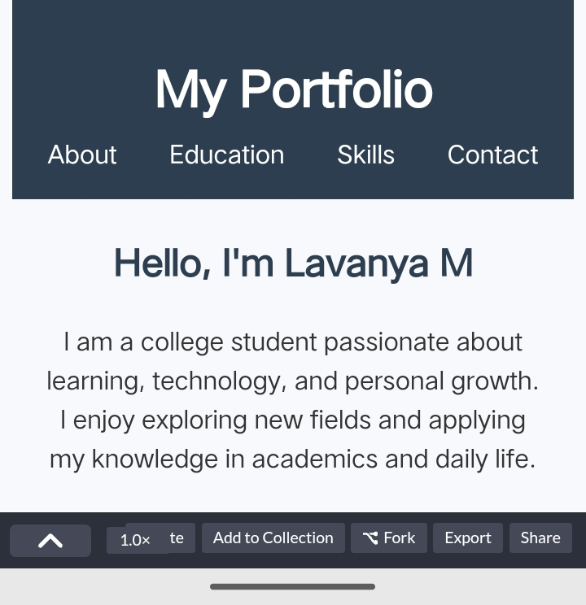
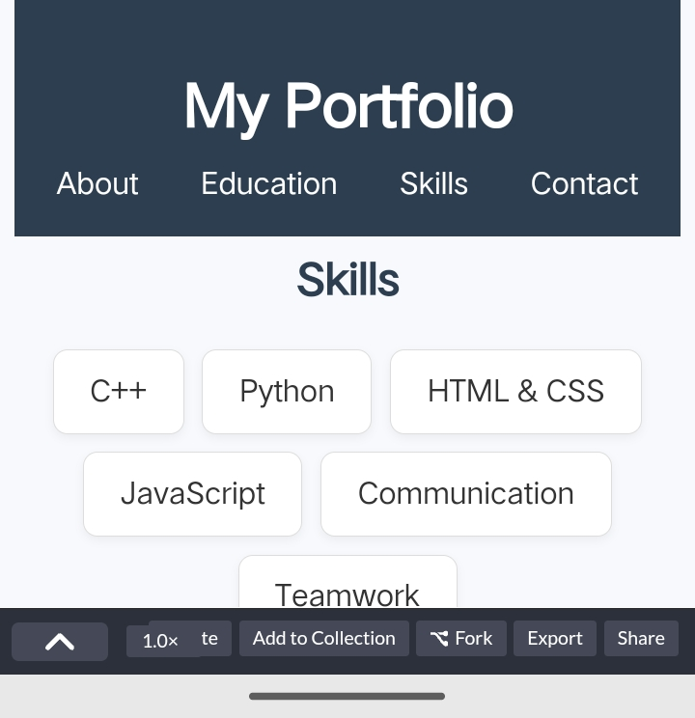
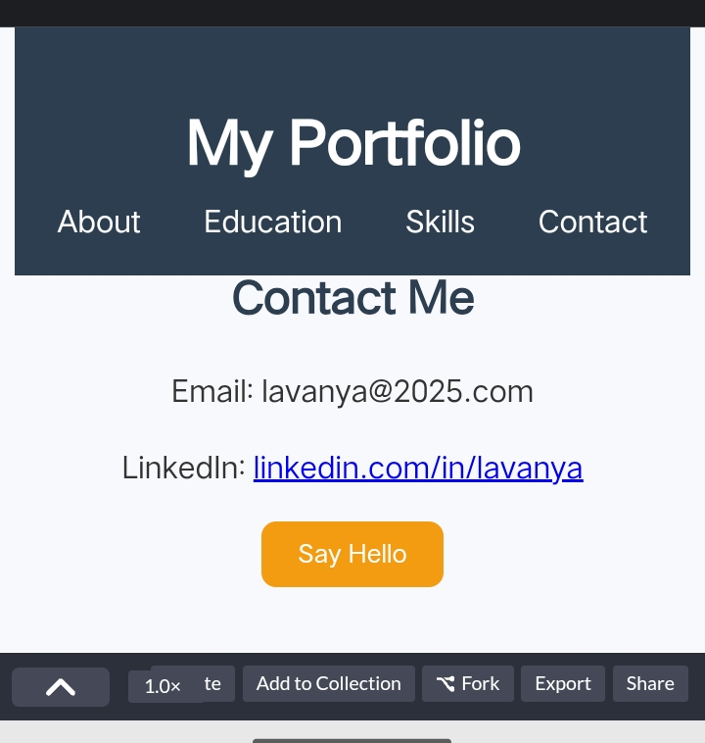
RESULTS

